Slide 1
AIHA8122 · FRONTIERS IN SMART HEALTHY AGEING
Artificial Intelligence (AI) -Machine Learning
Kefeng Li, PhD
E-mail: kefengl@mpu.edu.mo
Office: New Academic Building E1303-1 (Main Campus, Macau);
Bldg 11 Room 206 (Hengqin Campus)
Course webpage: https://canvas.mpu.edu.mo/
Office hours : Wednesday: 10 am -1 pm, and Thursday: 10 am - 1 pm

Slide 2


中秋佳節月正圓，
博士堂前講算連。
老齡康養智慧賦，
機器回歸莫等閒。
代碼調參度良夜，
銀發未來皆在先。
唯盼學子早畢出，
共赴明月把酒歡。

Slide 3
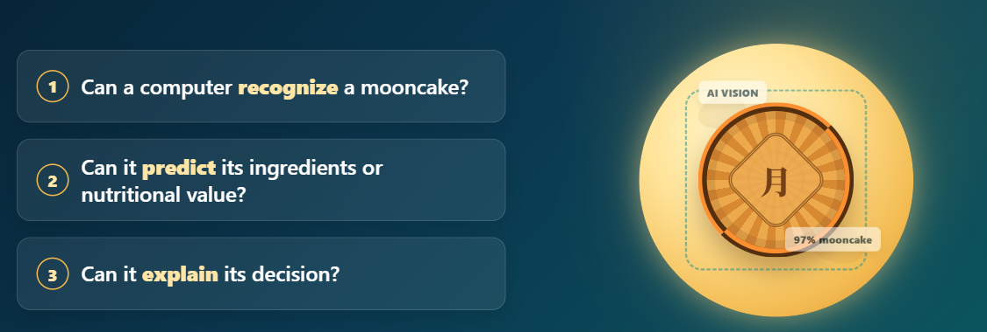
A Mid-Autumn Festival Question

Slide 4
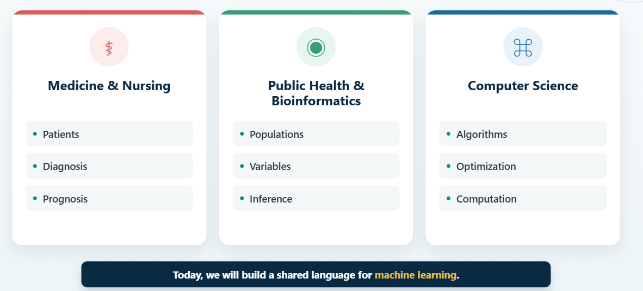
One Classroom, Three Disciplinary Languages

Slide 5
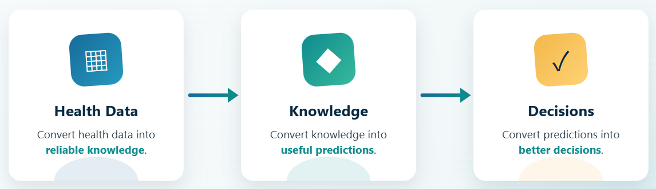
Our Shared Goal
Data → Knowledge → Prediction → Responsible Action

Slide 6
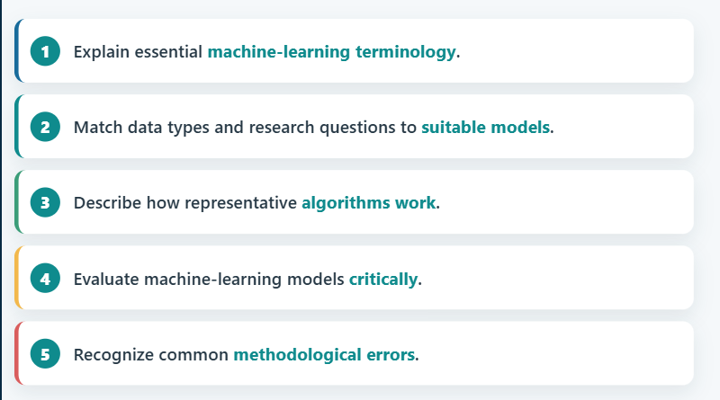
Learning Objectives

Slide 7
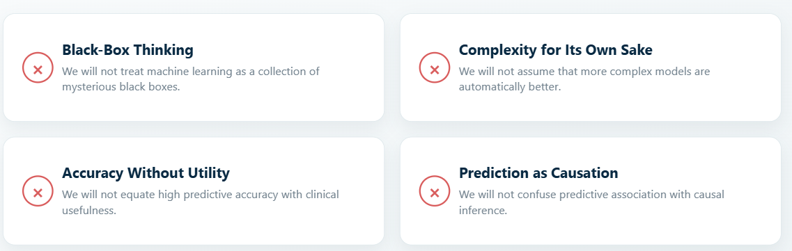
What This Class Will Not Do
Our principle: understand, evaluate, and apply models responsibly.

Slide 8
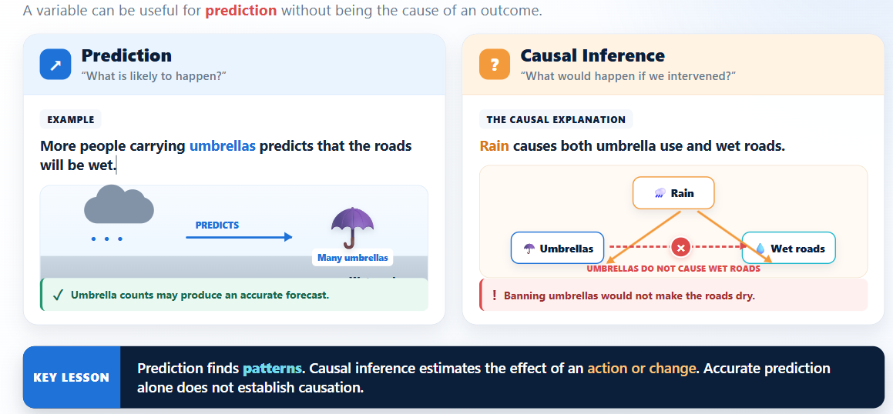
What This Class Will Not Do
Confuse Prediction with Causal Inference

Slide 9
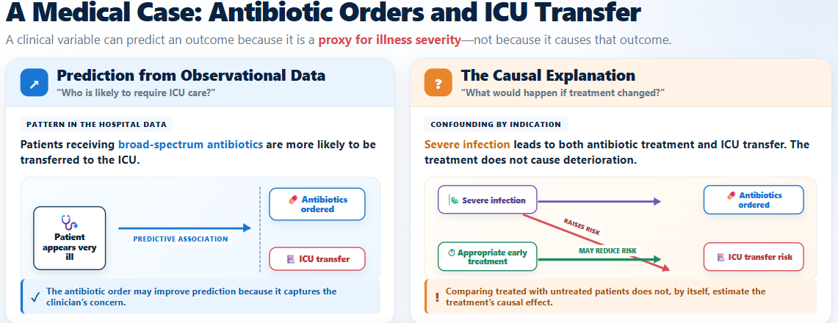
What This Class Will Not Do
Prefer factors linked to the disease pathway, such as infection evidence and organ dysfunction.
Explain why each feature is relevant to the clinical mechanism.
Treatment orders, hospital location and documentation patterns may be predictive but can produce misleading explanations and fail when clinical practice changes.
Build Clinician Trust
Favor clinically meaningful and causally grounded inputs where feasible

Slide 10
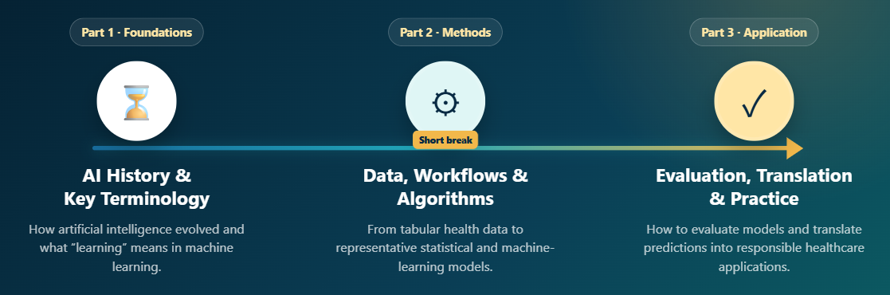
Our Learning Journey

Slide 11

01 From Artificial Intelligence to Machine Learning
01

Slide 12
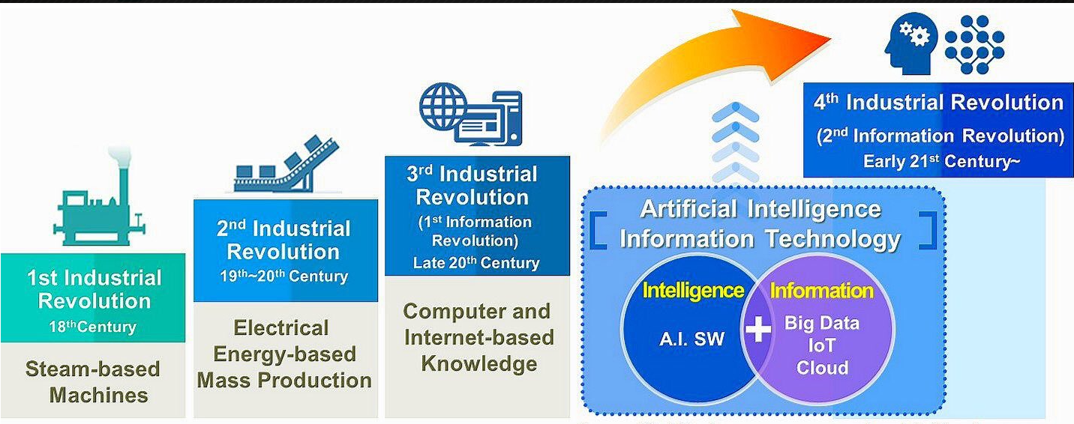
Stages of Industrial Revolution

Slide 13
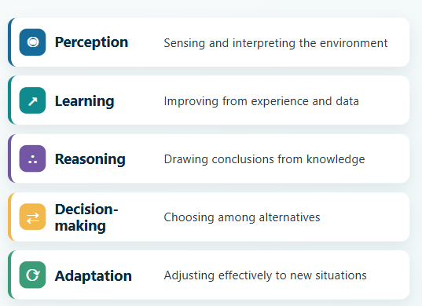
What Do We Mean by Intelligence?
Intelligence is not a single capability; it consists of perception, learning, reasoning, decision-making, and adaptation.
Intelligent behavior emerges when these capabilities are integrated to interpret the environment, make appropriate judgments, and take effective action.

Slide 14
What Do We Mean by Intelligence?
Intelligence is not a single capability; it consists of perception, learning, reasoning, decision-making, and adaptation.
Intelligent behavior emerges when these capabilities are integrated to interpret the environment, make appropriate judgments, and take effective action.

Slide 15
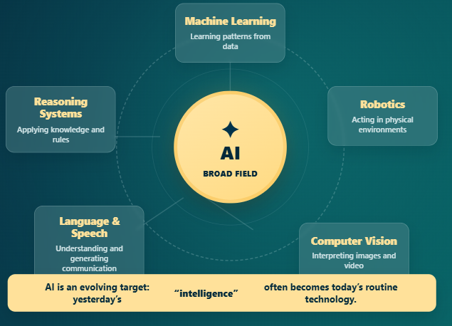
What Is Artificial Intelligence?
Machines performing tasks that we associate with human intelligence.
AI is a broad scientific and engineering field , not a single model or technique.
Multiple approaches can be used to create intelligent behavior.
Different AI systems may perceive, reason, learn, communicate, or make decisions.

Slide 16
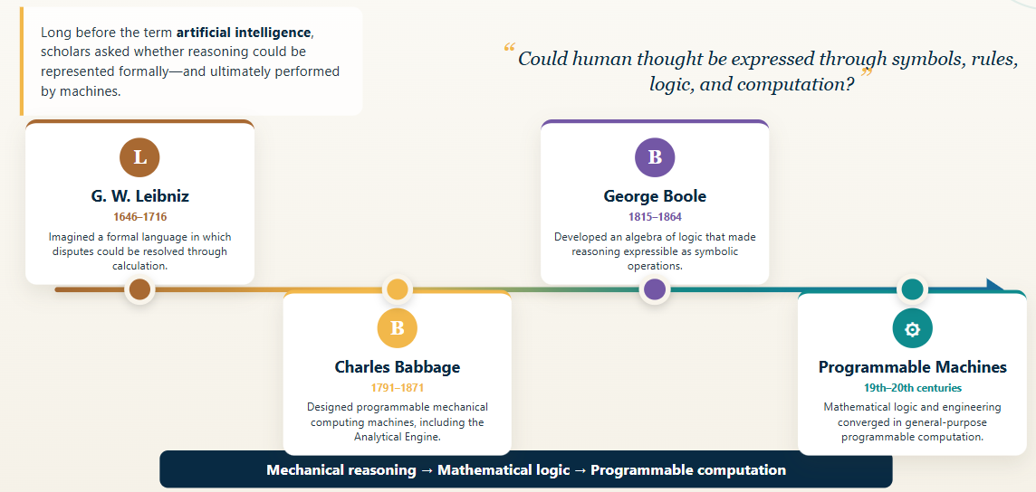
AI Before “Artificial Intelligence”
Notes:
这条时间线体现了一条重要的发展路径：从机械化推理，到数学逻辑，再到可编程计算，它们共同奠定了现代人工智能的基础。

Slide 17
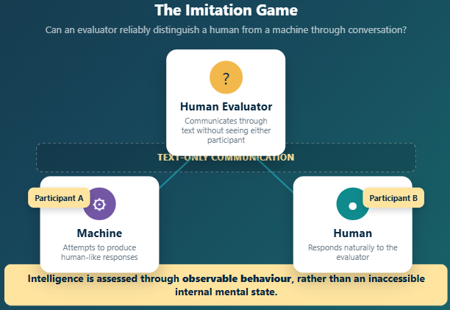
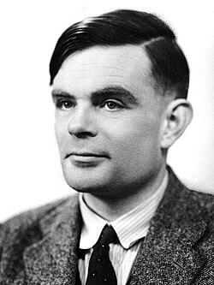
Alan Turing and Machine Intelligence
Can machines think?” (1950)
Shifted the question from 'what is thinking?' to 'what can we observe?'
The Imitation Game
A Creator of Computer Science

Slide 18
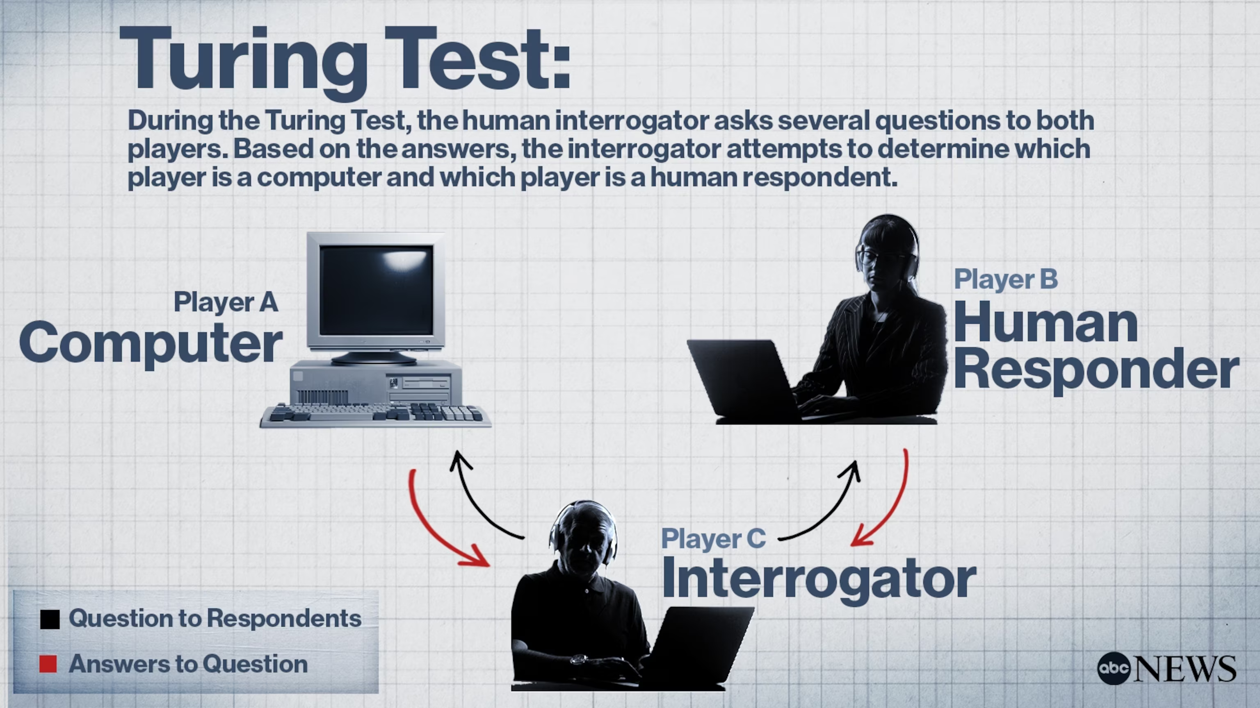
Alan Turing and Machine Intelligence
Can machines think?” (1950)
Shifted the question from 'what is thinking?' to 'what can we observe?'
The Imitation Game
The father of modern computing

Slide 19
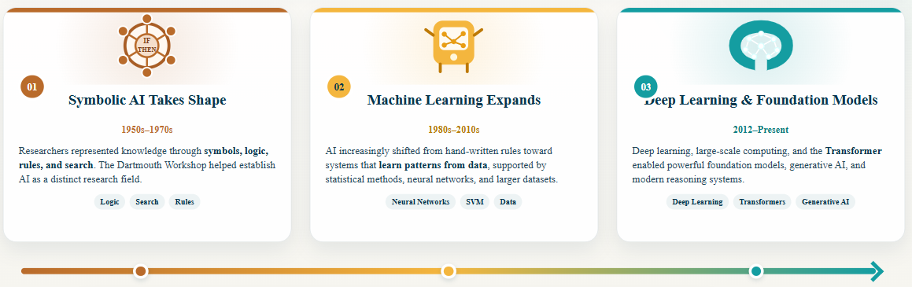
From Turing’s Question to Modern AI
A brief roadmap of how artificial intelligence has evolved
The methods changed—from rules to learning to foundation models — but the goal remained the creation of intelligent behavior.

Slide 20
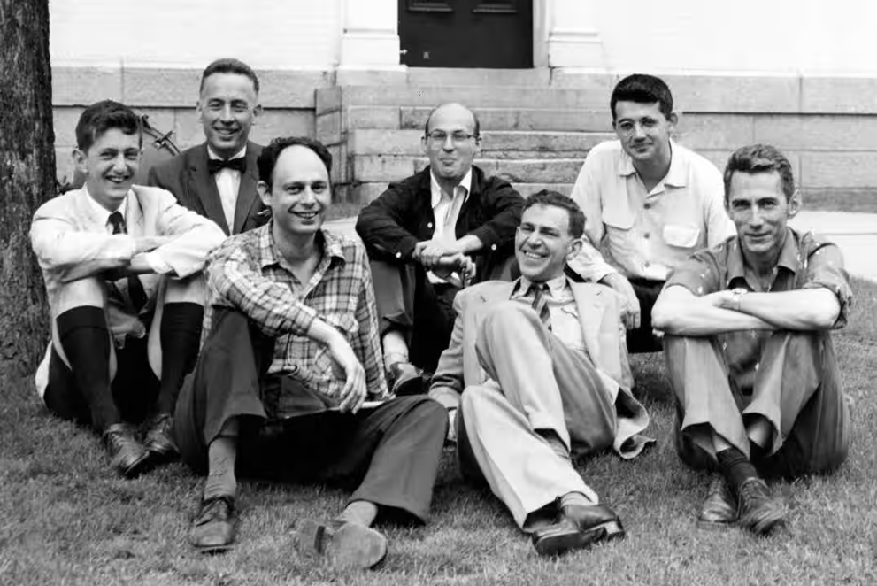
The Dartmouth Workshop of 1956
▪ Coined the term “artificial intelligence”
Artificial Intelligence (AI) refers to the branch of computer science dedicated to simulating human intelligence in machines, enabling them to perceive, think, learn, and reason like humans.
▪ Intelligence as something that might be formally described
▪ Beginning of AI as an academic discipline
Dartmouth workshop (1956)
John McCarthy

Slide 21
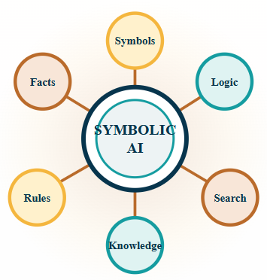
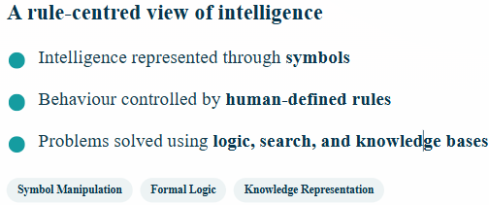
The Symbolic AI Era
Intelligence was represented as symbols that could be manipulated by formal rules
No learning-just rules written by humans. Human-defined rules and logic

Slide 22
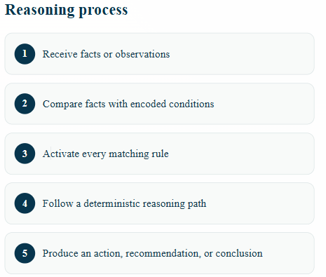
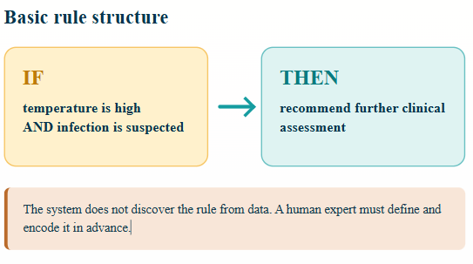
How a Rule-Based System Works
Expert knowledge is translated into explicit rules that guide the system toward a conclusion

Slide 23
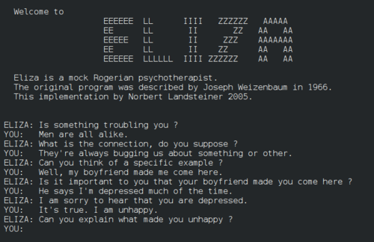
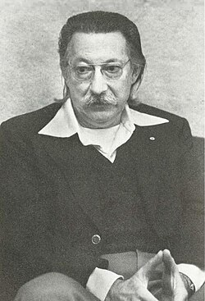
ELIZA: Simulating Conversation
ELIZA, the Psychotherapist: One of the most iconic products from the era of symbolic Artificial Intelligence (AI).
The Core Creed: It perfectly demonstrates the central belief of that era—simulating human-like behavior through predefined rules and symbol (keyword) manipulation.
Contextual Simulation: It proves that machines can mimic human responses within specific contexts without true understanding.
1964 – 1966 by MIT
Joseph Weizenbaum

Slide 24
1. Patient: "I have been feeling a lot of pressure from my mother lately.“
ELIZA: ?
Rule 1
If Keyword = "father" or "mother“
Then “Tell me more about your [Keyword]."
2. Patient: “I love my mother”
ELIZA: ?
Reflect the conversation of a psychotherapist of the Rogerian school
3. Patient: “My mother is sick”
ELIZA: ?
4. Patient: “I hate my mother's cooking.”
ELIZA: ?
Key limitation: ELIZA created the appearance of understanding without semantic understanding of the conversation. ELIZA Effects

Slide 25
ELIZA vs. Modern GPT
The Scenario: A user inputs: "My mother is sick."
Today: GPT (Generative AI / LLM)
  Response: "I'm so sorry to hear that... How are you holding up?"
  How it works: Contextual semantic understanding.
  The upgrade: It predicts the most empathetic response based on massive data patterns.
1966: ELIZA (Symbolic AI)
Response: "Tell me more about your mother."
How it works: Rigid keyword matching.
The flaw: It detects "mother" but completely ignores the meaning of "sick" (sounds cold and robotic).

Slide 26
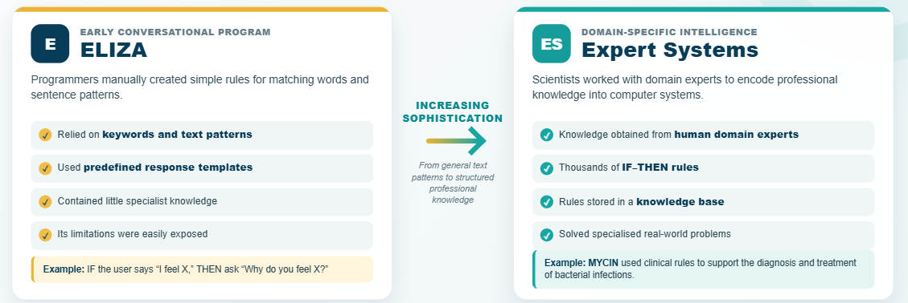
From ELIZA to Expert Systems

Slide 27
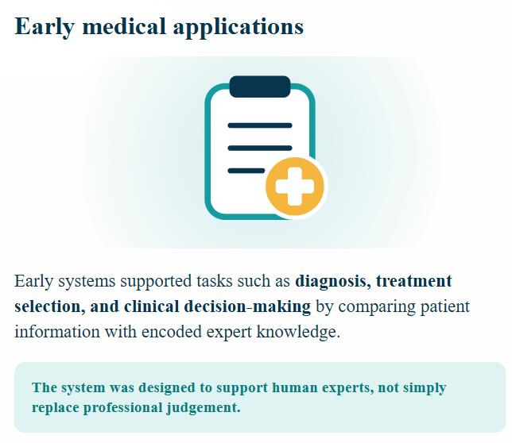
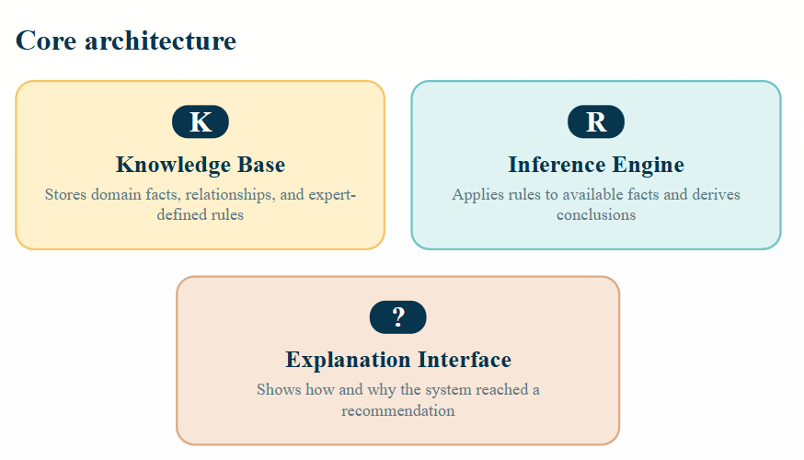
Expert Systems
Expert systems combined specialized knowledge with a reasoning mechanism and an explanation interface

Slide 28
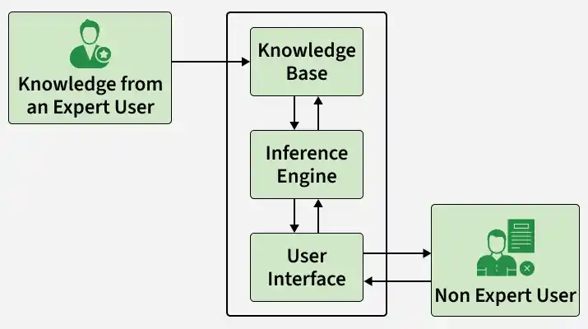
Expert Systems
MYCIN: A Clinical Decision Support System (Standford – 1970~)
An influential rule-based program that applied expert knowledge to infectious-disease diagnosis and antimicrobial therapy selection.
Developed through the Stanford Heuristic Programming Project
Encoded specialist knowledge as IF–THEN production rules
Used backward-chaining goal-directed reasoning (Like the doctor seeing the patients)
Represented uncertainty using certainty factors
Example rule
IF the organism is gram-negative, rod-shaped and anaerobic, THEN there is suggestive evidence that it is Bacteroides.

Slide 29
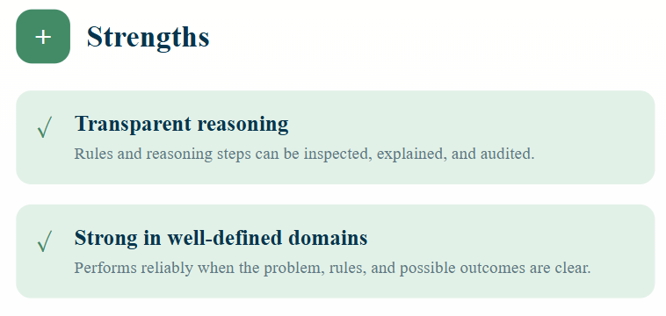
Strengths and Weaknesses of Symbolic AI

Slide 30
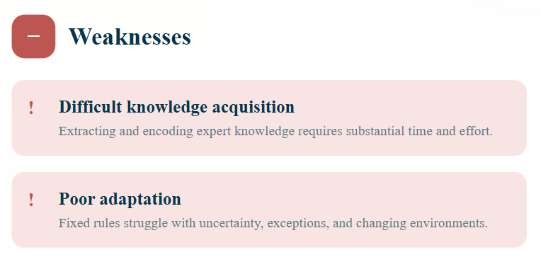
Strengths and Weaknesses of Symbolic AI
Expert systems demonstrated the power of encoded knowledge—but manually creating and maintaining thousands of rules was difficult.

Slide 31
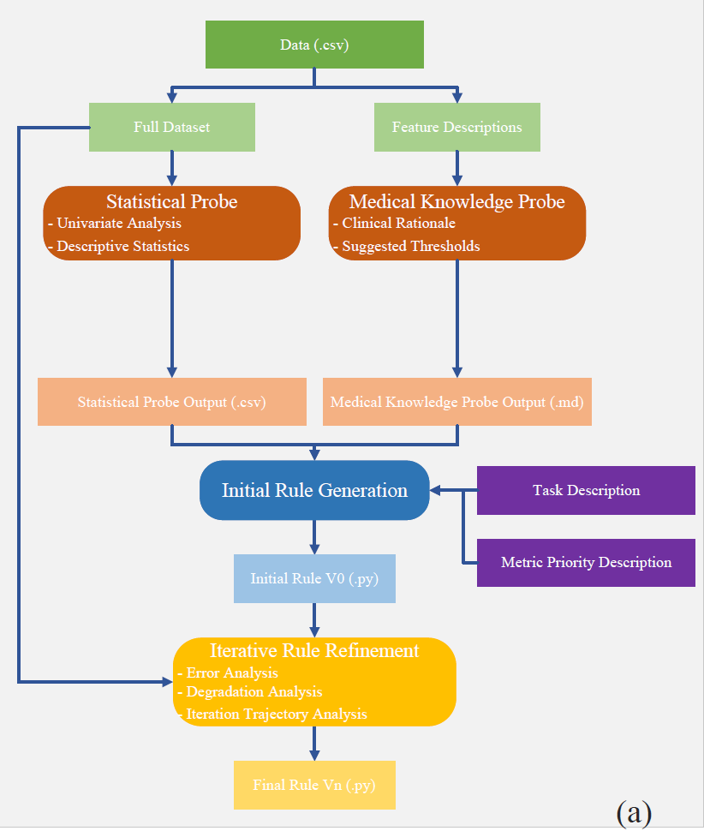
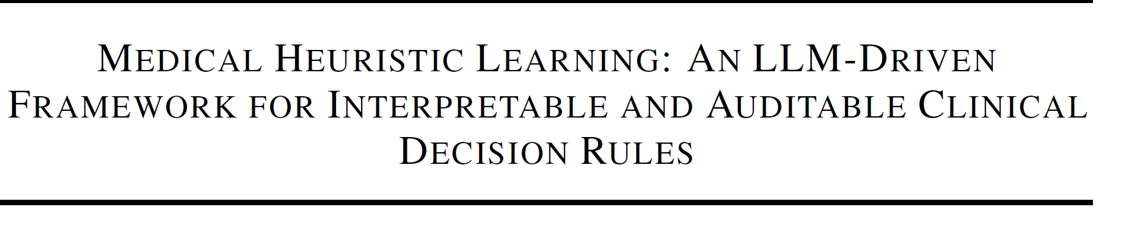
Medical Heuristic Learning (MHL)
Traditional expert systems encode what experts already know;
Medical Heuristic Learning continuously learns how to improve executable medical knowledge from experts, data, and observed errors.
Rules are jointly derived from medical knowledge, clinical data, and LLM reasoning.
The model is an executable heuristic program—not a fixed parameterized network.
Clinical knowledge is represented as transparent, self-contained if–then rules and scoring logic.
A closed-loop architecture for rule evolution.
Statistical probing → rule generation → error analysis → minimal code revision → regression testing.
IEEE Transactions on Evolutionary Computation (IF: 15.9, Peer Review)

Slide 32
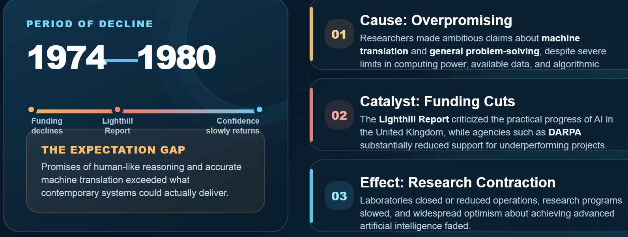
The First AI Winter (1974 – 1980)
An AI winter is a period of reduced funding, public interest, and commercial activity following intense hype and unmet expectations

Slide 33
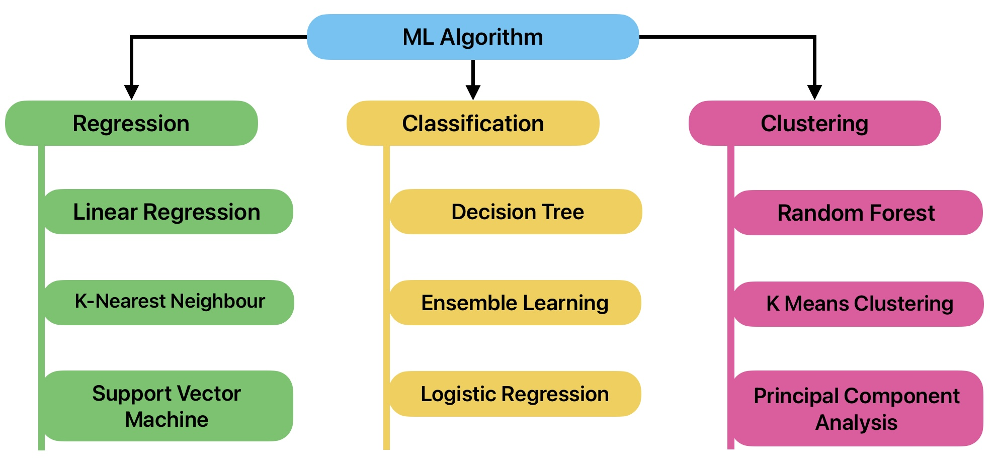
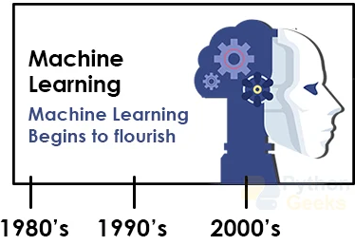
The Rise of Machine Learning (1980 – 2010)
The Shift from Rule-Based Symbolism to Data-Driven Statistical Learning
Core Philosophy: Using statistical concepts to train machines with massive amounts of data, allowing them to learn underlying patterns and make predictions just like a human
Machine learning broke through the traditional bottleneck of relying on explicit human programming.
This enabled it to solve complex, ambiguous, and data-rich real-world problems. Its rise represents a major revolution in the history of AI development.

Slide 34
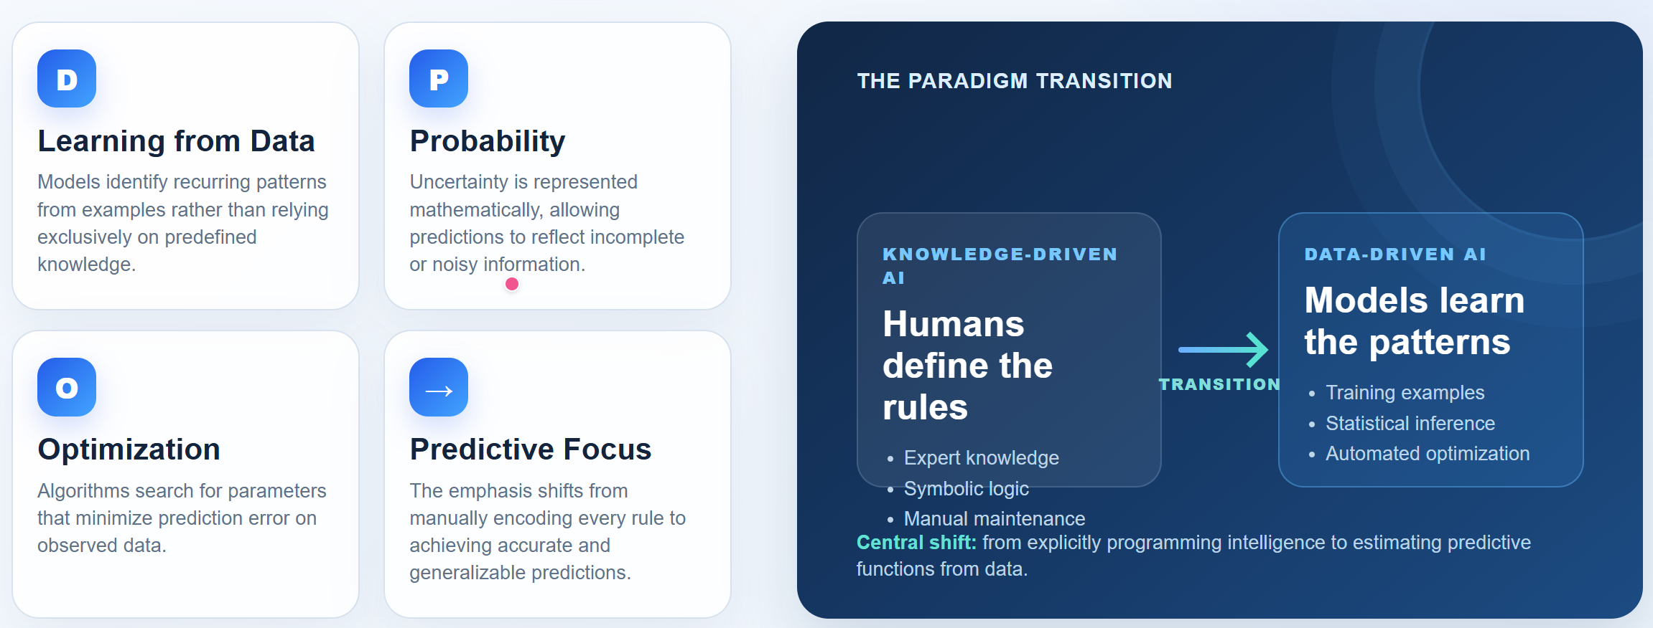
The Rise of Machine Learning (1980 – 2010)
AI systems increasingly learned predictive patterns directly from observed data

Slide 35
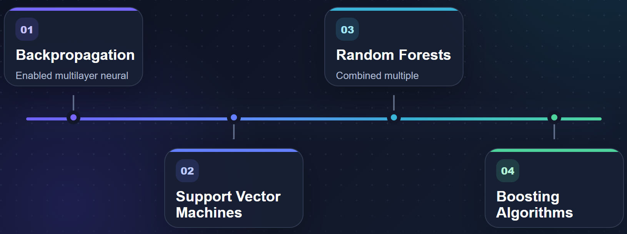
Important Machine-Learning Milestones
Four influential advances expanded the accuracy, flexibility, and practical reach of machine learning
AdaBoost
Collective impact: Increasingly powerful models capable of learning nonlinear patterns from complex data

Slide 36
Four funding ideas for machine learning
Backpropagation — Learn by Optimizing Errors (誤差優化）
SVM — Maximize the Decision Margin (最大間隔)
Boosting — Correct Previous Mistakes (逐步糾錯)
Random Forest — Combine Diverse Models (集成投票)

Slide 37
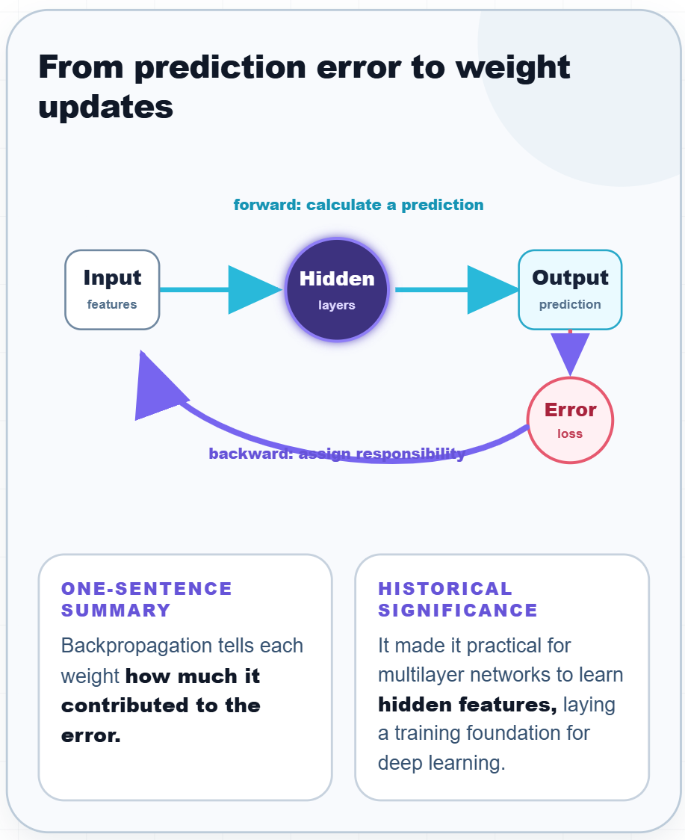
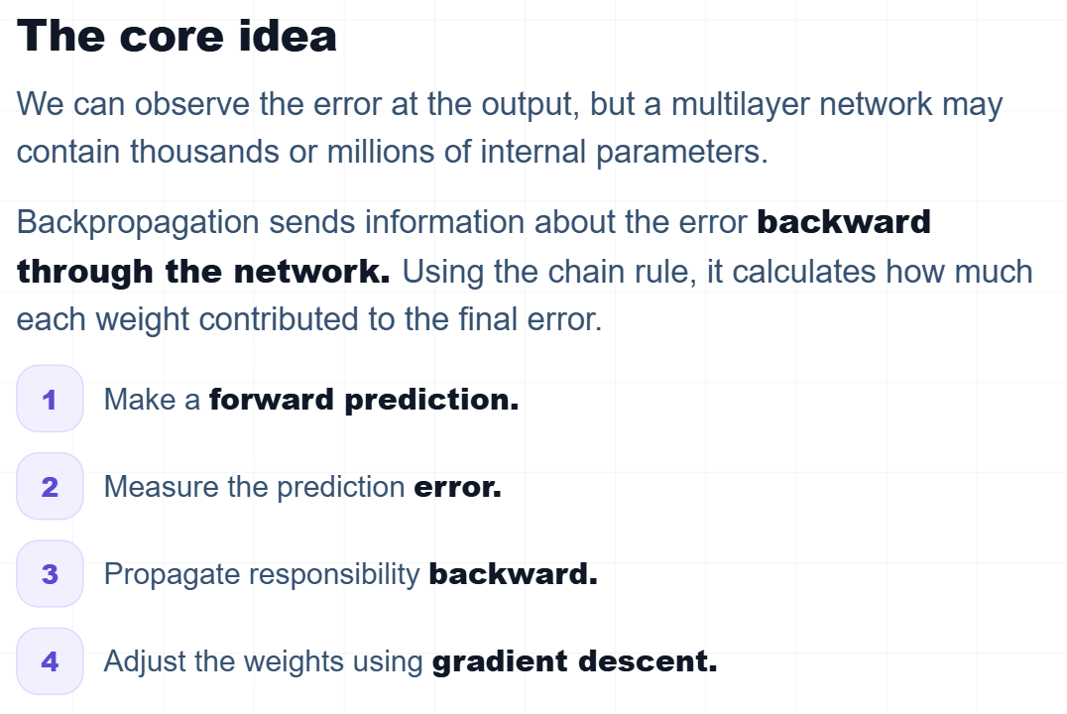
Neural Network Training--Backpropagation (1986)
Learn by optimizing errors
If a neural network makes a mistake, how does it know which internal weights are responsible?

Slide 38
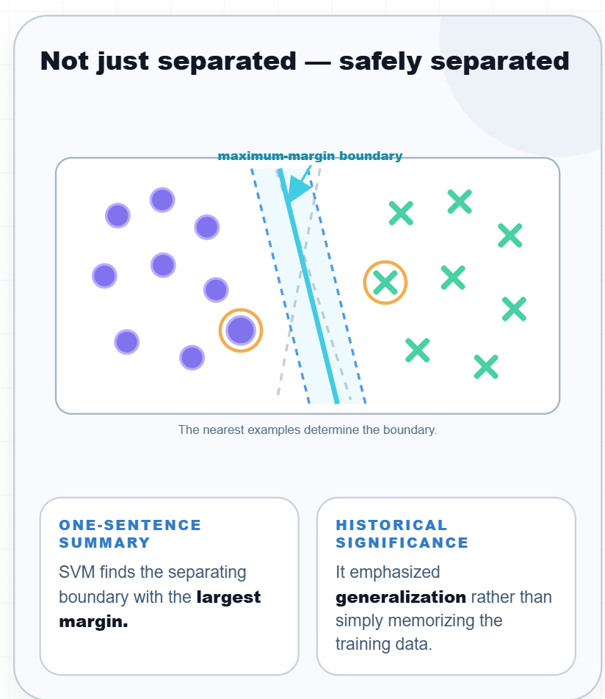
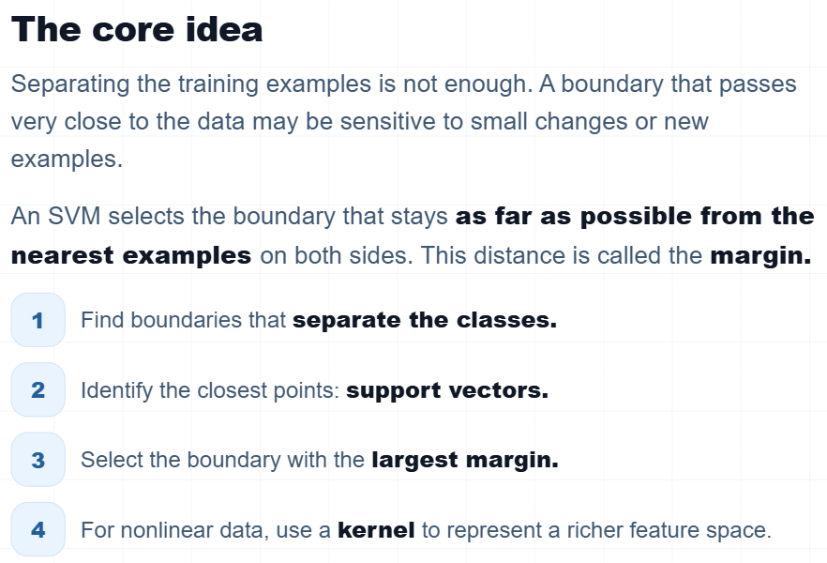
Support Vector Machines (1995)
Maximize the decision margin
If several boundaries classify the training data correctly, which boundary should we choose?

Slide 39
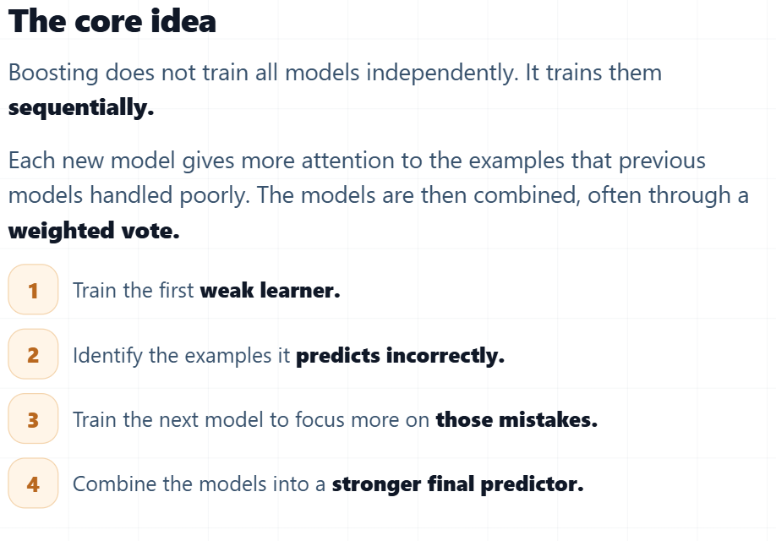
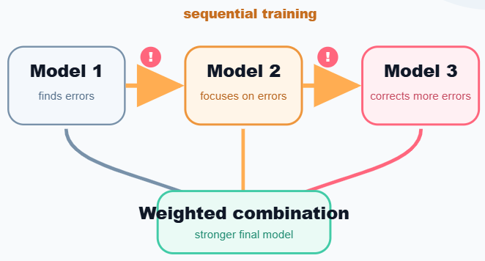
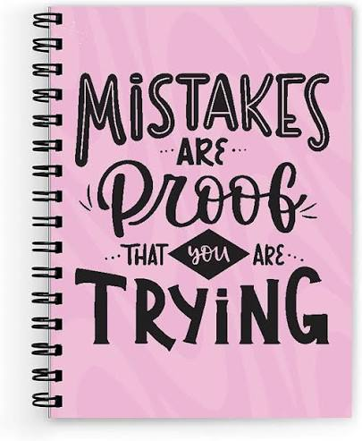
Boosting (1995 - 1996)
Correct previous mistakes
What if each new teacher focused on the questions that students still answered incorrectly?
When you practice, you don't keep rewriting the questions you already got right. Instead, you create a 'Mistake Set' (錯題集). You highlight your errors, give them more of your attention and energy, and study them until you get them right.
This is exactly what AdaBoost does by dynamically raising the weights of misclassified samples for the next algorithm iteration."
Each model learns from the previous errors

Slide 40
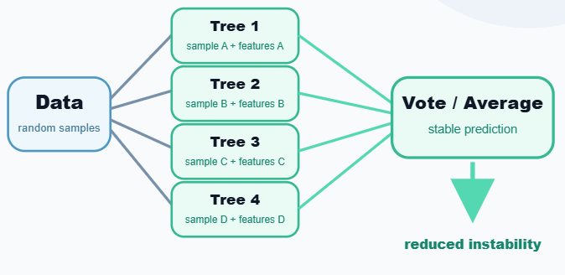
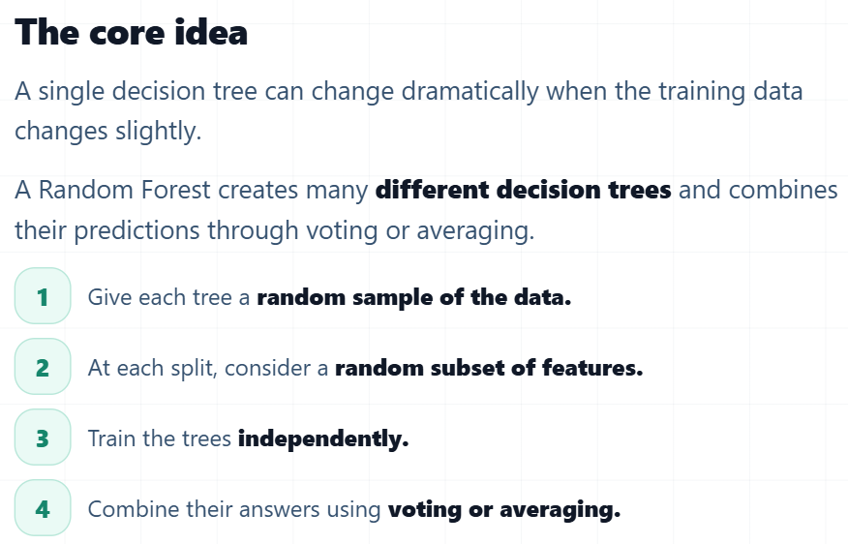
Random forest (2001)
Combine diverse models
Many different trees, one stable prediction
Why trust one unstable decision tree when we can ask many different trees and combine their answers
Random Forest reduces instability by averaging many diverse decision trees.
It made ensemble learning stable, practical, and easy to use.
Do not confuse Random Forest with Boosting.
Random Forest
Trees are trained relatively independently using random data and feature subsets.
Boosting
Models are trained sequentially, and later models focus on previous errors.

Slide 41
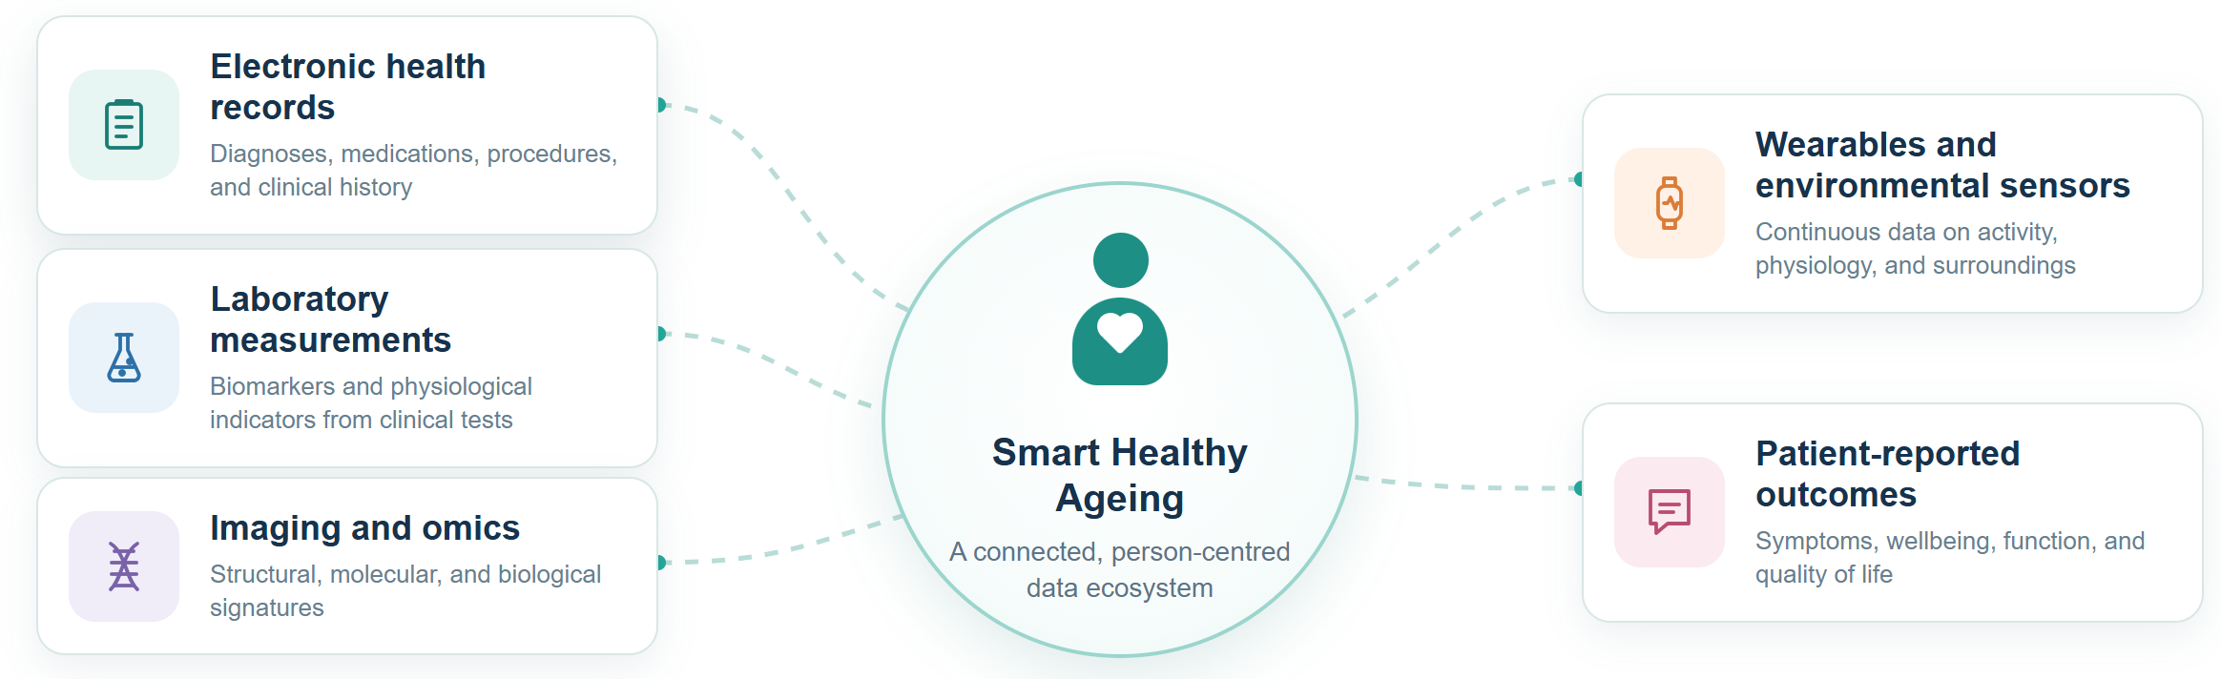
The Data Landscape in Smart Healthy Ageing

Slide 42
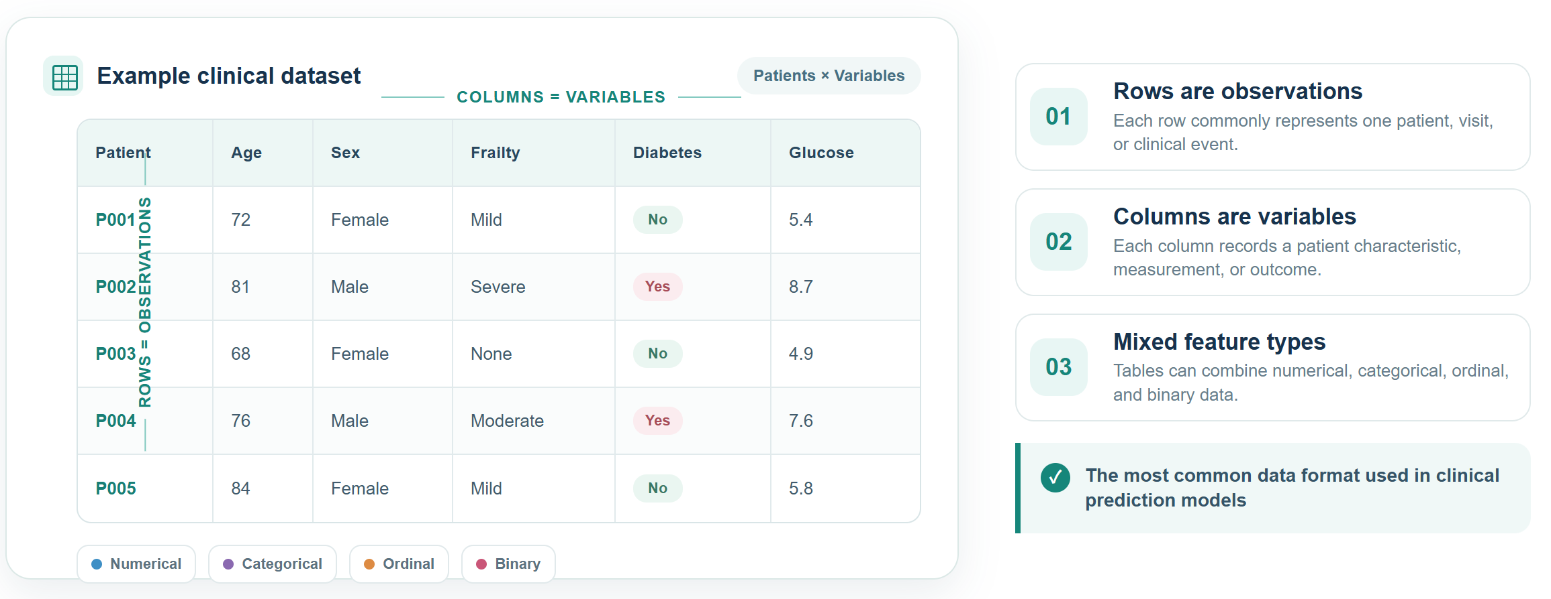
Tabular Data
Tabular structure converts patient information into a machine-learning-ready matrix.

Slide 43
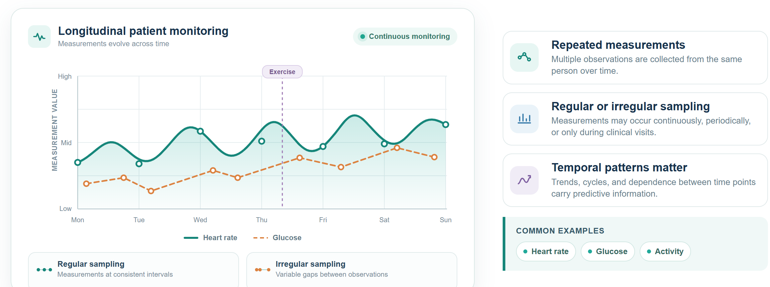
Time-Series Data
Time-series models use both measurement values and their temporal ordering.

Slide 44
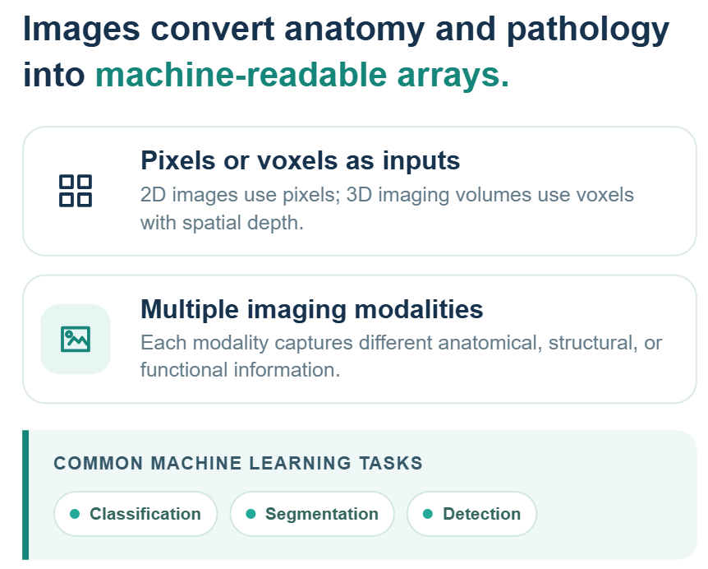
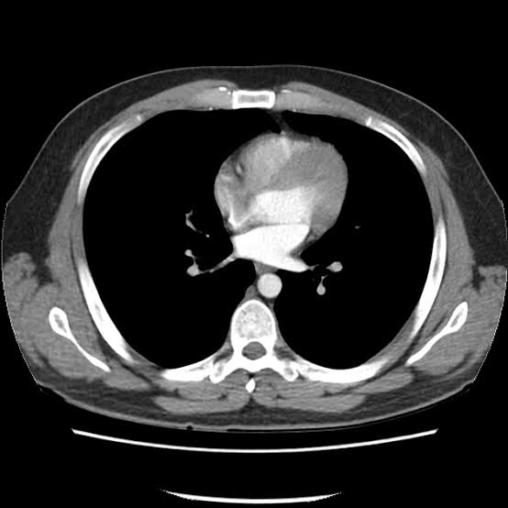



Medical Images
Digital imaging workspace
CT
MRI
Ultrasound
Pathological images
Spatial patterns in medical images can reveal disease, anatomy, and treatment response.

Slide 45

Clinical Text
Clinical text requires language processing to transform narrative documentation into usable features.

Slide 46

Omics Data
High dimensional; Correlated features
Omics analysis often requires feature selection, regularization, and careful validation

Slide 47

Graph Data
Graph learning uses relationships and neighborhood structure as predictive information.

Slide 48

Multimodal Data
Data type determines representation, model design, validation strategy, and interpretation.

Slide 49

Cross-Sectional and Longitudinal Data
Longitudinal data add temporal information but require methods that account for repeated observations.

Slide 50

Static and Dynamic Prediction
Dynamic models can be more responsive, but they require reliable and timely data updates.

Slide 51

Major Prediction Tasks
Choosing the task is a scientific decision, not merely a choice of algorithm.

Slide 52

Binary Classification
Evaluate both probability quality and the consequences of the selected decision threshold.

Slide 53

Multiclass and Multilabel Classification
Before modeling, ask whether the labels are mutually exclusive. The answer determines the model output and loss function.

Slide 54

Regression
Regression preserves numerical information that would be lost by converting a continuous outcome into categories

Slide 55


Survival Prediction
Risk changes across follow-up time
Standard classification can be misleading when follow-up differs or many observations are censored.

Slide 56

Translating a Clinical Problem into an ML Task
Precise task definition prevents leakage, clarifies evaluation, and connects predictions to decisions.

Slide 57
Translating a Clinical Problem into an ML Task
Precise task definition prevents leakage, clarifies evaluation, and connects predictions to decisions.

Slide 58

Information Leakage
Information leakage occurs when a model uses information that would not genuinely be available when the prediction is made, or when information improperly crosses dataset partitions. Use only information available at prediction time.
Leakage check before model training: (1) Could this variable exist at the stated prediction time?; (2) Is this variable a consequence or proxy of the outcome? (3) Are patients completely separated across data partitions?

Slide 59


The HRS-Family of Global Aging Cohorts

Slide 60

China Health and Retirement Longitudinal Study

Slide 61

English Longitudinal Study of Ageing

Slide 62

Survey of Health, Ageing and Retirement in Europe

Slide 63

Longitudinal Ageing Study in India

Slide 64

Mexican Health and Aging Study

Slide 65

Global Flourishing Study (GFS)
Cross-cultural evidence on human flourishing across adulthood

Slide 66

VitalDB (Vital Signs DataBank)
High-resolution physiological data from surgeries under anesthesia
South Korea

Slide 67

Korea Community Health Survey
Annual nationwide surveillance of community health across South Korea
Geographic coverage: Nationwide, South Korea

Slide 68

Mapping Datasets to Machine Learning Tasks

Slide 69

Mapping Datasets to Machine Learning Tasks

